Slide 1
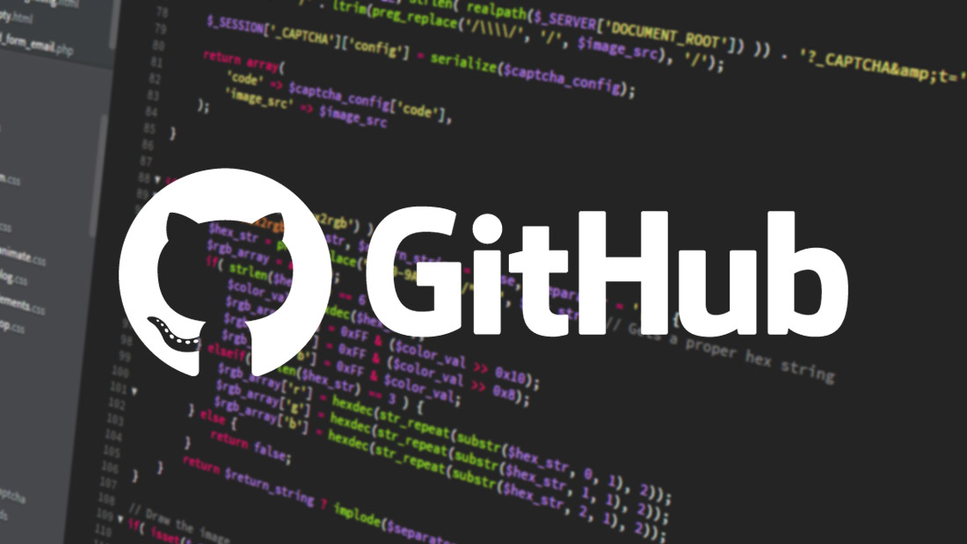
GitHub: A Essential Tool for Programmers
Speakers:
Andres Reyes
Javier Bermudez
Jose Ortiz

Slide 2

What is GitHub and how does it benefit programmers?
GitHub is a tool that helps programmers work together on software projects. It uses the Git version control system to keep track of changes and manage the project. It's important for storing, sharing, and collaborating on projects, whether team members are in the same place or working from different locations.
Version Control: GitHub provides detailed tracking of code changes. Each modification is saved as a "commit," allowing easy reversion to previous versions or comparison of changes over time.
Collaboration: GitHub streamlines teamwork with "pull requests," allowing others to review proposed code changes before they're accepted and merged into the main project. It also helps prevent conflicts when multiple developers work on the same code sections.
Storage and Backup: GitHub acts as a cloud-based repository for code, allowing access and recovery of the code from anywhere with an internet connection.
https://github.com/

Slide 3
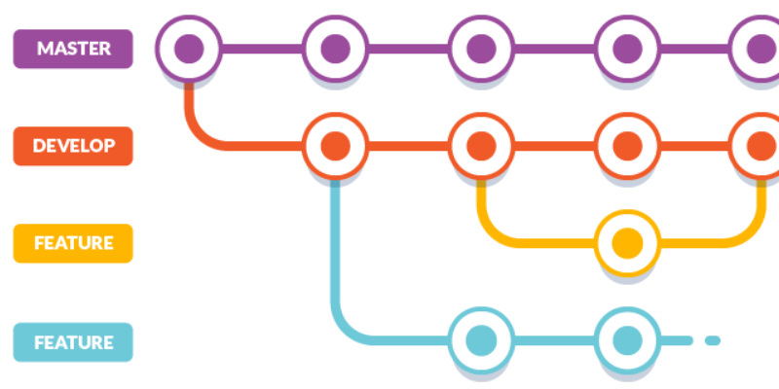
The importance of version control
Version control is crucial because:
Prevents data loss: With a version history, you can always recover an earlier version of the code if errors are made or if a new feature doesn't work as expected.
Facilitates collaboration: It allows multiple programmers to work on the same project at the same time without deleting each other's work. Each developer can work in their own development branch and merge changes when ready.
Documentation and tracking: Every change is recorded with a message explaining what was done, so it's easier to follow the project's progress.

Slide 4
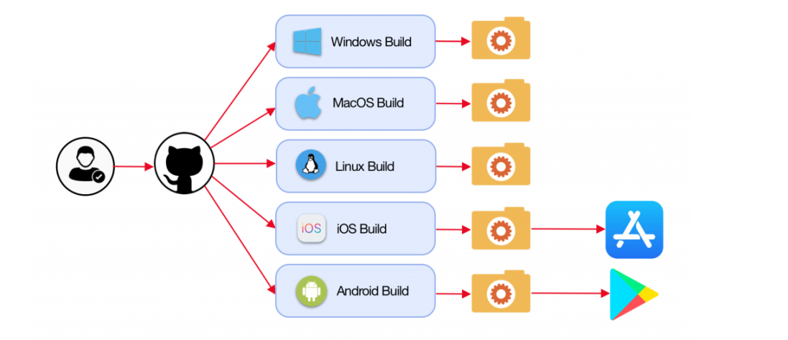
Ease of use
GitHub is very user-friendly, offering an intuitive web interface that allows us to:
Create repositories to store our projects.
Make commits directly from the browser or from the command line with Git commands.
View the history of changes and branches in the project.
Automate tasks through integrations with CI/CD tools (like GitHub Actions), which help us to run automated tests and deployments.
IN CONCLUSION
GitHub is essential for programmers to manage, collaborate, and track code efficiently.

Slide 5
Thank you for your attention.

